Slide 1
Optical packet switching

Slide 2
Optical packet switching
OPS
  Optical circuit switching (OCS) is viable solution that can be realized using mature optics & photonics technologies
  Ultimately, however, economics will demand that network resources are used more efficiently by decreasing switching granularity from wavelengths to optical packets => optical packet switching (OPS)
  Benefits of OPS
    Supports bursty data traffic more efficiently than OCS by means of statistical multiplexing
    Connectionless service helps reduce network latency by avoiding two-way reservation overhead of OCS
    Unlike OBS, OPS does not require burst assembly algorithms, separate control wavelength channel, nor any offset time

Slide 3
Optical packet switching
Electro-optical bottleneck
  Most concepts used in OPS are borrowed from electronic counterparts such as ATM switches & IP routers
  OPS attempts to mimic electronic packet switching in optical domain while taking shortcomings & limitations of current optics & photonics technology into account
  Key challenge in OPS involves developing elegant solution to so-called electro-optical bottleneck
    In principle, electro-optical bottleneck could be alleviated by increasing degree of parallelism at electronic layer => increased complexity, power consumption, cost, and footprint
    Instead of parallelism, electronic switches/routers can be offloaded by using low-cost optics & photonics technology and performing part of switching/routing in optical domain
      Reduced complexity, footprint, and power consumption
      Improved performance & significant cost savings

Slide 4
Optical packet switching
Overview & limitations
  Research on OPS networks started in mid 1990s
    RACE ATMOS (ATM optical switching) project
      Photonic technologies used to enhance node throughput, speed, and flexibility of ATM switching systems
    ACTS KEOPS (keys to optical packet switching) project
      Development of OPS network node architectures using optical packets of fixed duration
  OPS networks face challenges due to lack of optical RAM & difficulty to execute complex computations & logical operations using only optics & photonics without OEO conversion
  Interesting approach to realize practical OPS networks in near term is so-called optical label switching (OLS)

Slide 5
Optical packet switching
OLS
  May be viewed as particular implementation of OPS
  Only packet header (label) processed electronically for routing purposes while payload remains in optical domain
  Label can be differentiated from payload in several ways (e.g., diversities in time, wavelength, and modulation format)
  In general, label encoded at lower bit rate compared to payload
  OLS router performs following basic functions
    Label extraction
    Electronic label processing => routing information
    Optical payload routing & contention resolution
    Label rewriting & recombining with optical payload
  OLS enabling technologies include optical label generation, optical label swapping, optical buffering, clock recovery, and wavelength conversion

Slide 6
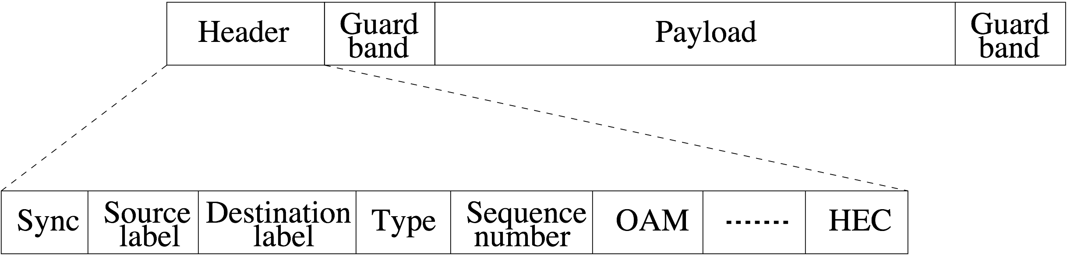
Optical packet switching
Generic packet format
  Generic optical packet format consists of
    Header
    Payload
    Additional guard bands before & after payload

Slide 7
Optical packet switching
Packet header
  Header may comprise following fields
    Sync: Delineation & synchronization bits
    Source Label: Source node address
    Destination Label: Destination node address
    Type: Type & priority of packet and carried payload
    Sequence Number: Packet sequence number to reorder packets arriving out of order & guarantee in-order packet delivery
    OAM: Operation, administration, and maintenance functions
    HEC: Header error correction

Slide 8
Optical packet switching
Packet header encoding/decoding
  Several methods exist for encoding packet headers, e.g.,
    Header encoded at lower bit rate than payload in order to simplify electronic processing of header
    Header can be subcarrier multiplexed (SCM) with payload
  Typically, small portion of optical power of arriving packet is tapped off at intermediate OPS node & header is OE converted and processed electronically, as done in OLS
  All-optical packet header processing currently allows only for simple operations such as label matching using optical correlator
    Optical correlator recognizes address by generating auto-correlation pulses when packet destination address matches signature of optical correlator

Slide 9
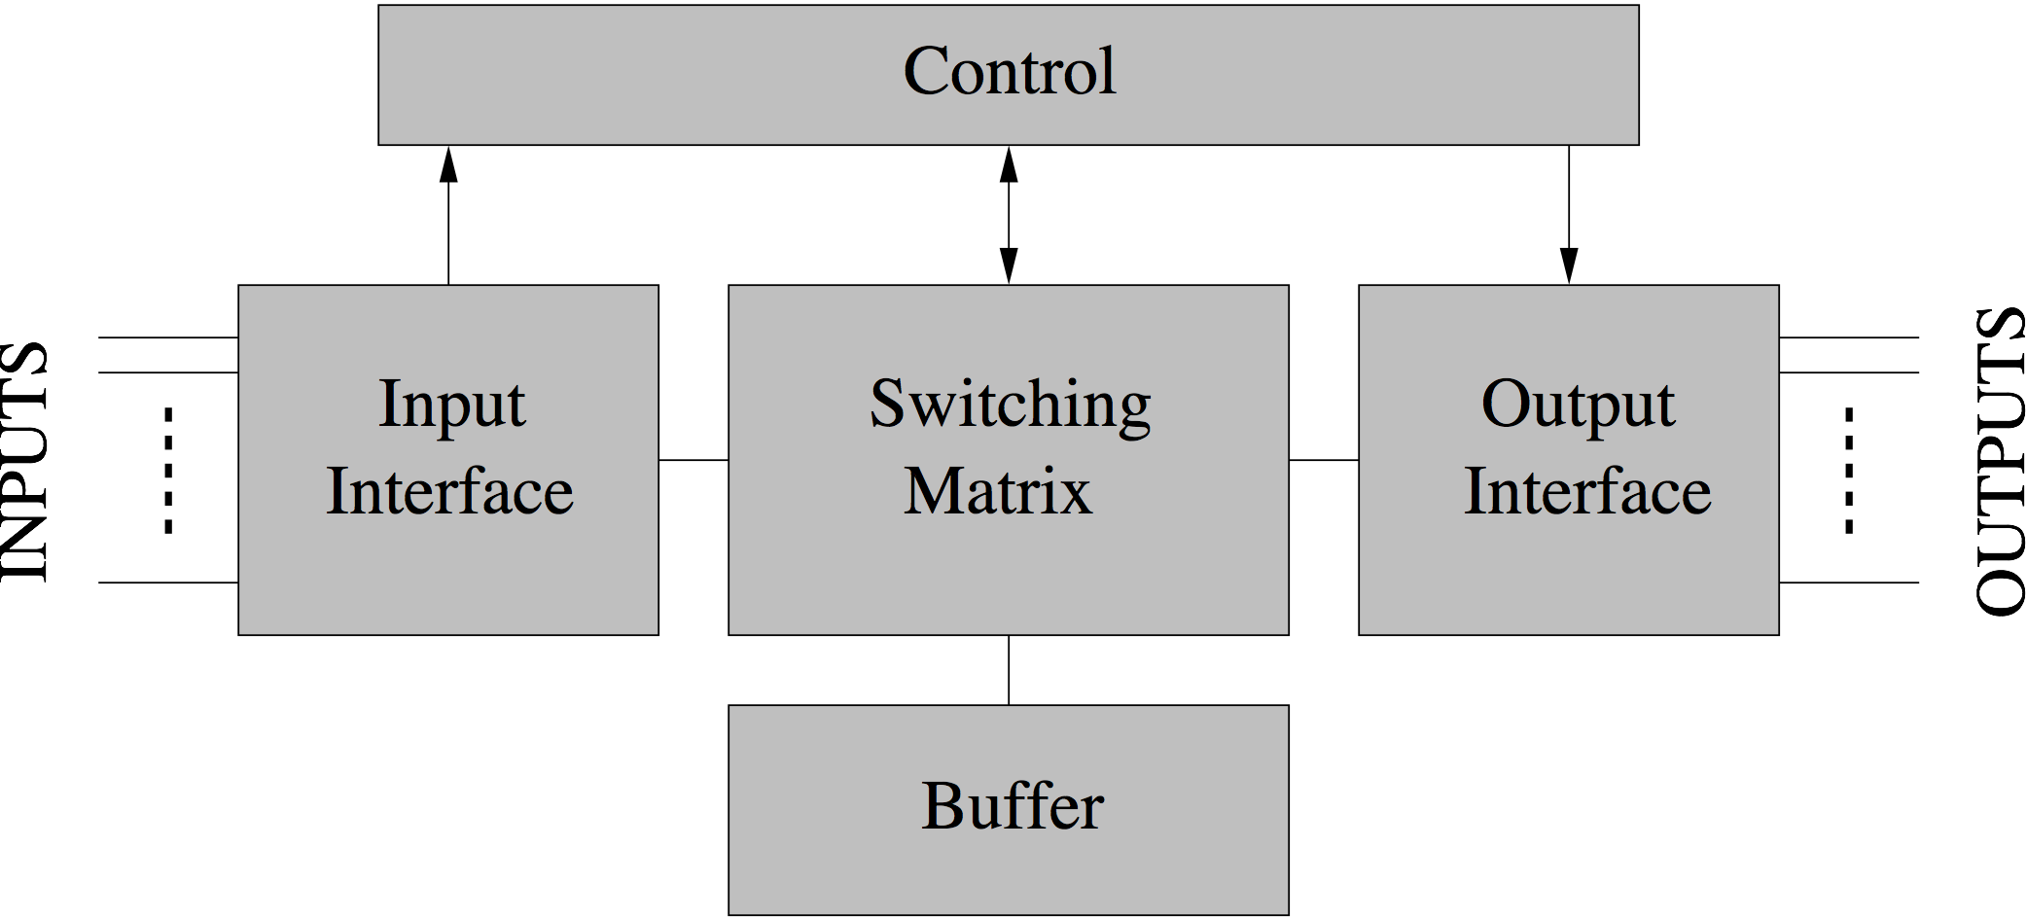
Optical packet switching
Generic switch architecture
  OPS node has multiple input & output ports and consists of
    Input interface
    Switching matrix
    Buffer
    Output interface
    Electronic control unit

Slide 10
Optical packet switching
Generic switch architecture
  Input interface
    Packet delination
      Identification of beginning and end of packet header & payload
    Wavelength conversion
      Conversion of external to internal wavelength, if necessary
    Synchronization (only in synchronous switches)
      Phase alignment of packets arriving on different wavelengths & input ports
    Header processing
      Packet header is extracted, OE converted, decoded, and forwarded to control unit for electronic processing
  Control unit
    Processes routing information & configures switch
    Updates header information & forwards header to output interface

Slide 11
Optical packet switching
Generic switch architecture
  Switching matrix
    Optical switching of payload according to commands from control unit
    Contention resolution
  Output interface
    3R (reamplification, reshaping, retiming) regeneration
    Attaches updated header to corresponding optical packet
    Packet delineation
    Conversion of internal to external wavelength, if necessary
    Resynchronization (only in synchronous switches)

Slide 12
Optical packet switching
Slotted vs. unslotted OPS networks
  OPS networks can be categorized into
    Slotted networks
      Packets are of fixed size & are placed in time slots
      Each time slot contains single packet consisting of header, payload, and additional guard bands
      OPS nodes operate in synchronous fashion with aligned slot boundaries (e.g., by using SDLs)
    Unslotted networks
      Packets can be of variable size
      Time is not divided into slots
      OPS nodes operate asynchronously without requiring any alignment of slot boundaries

Slide 13
Optical packet switching
Synchronous vs. asynchronous switches
  Synchronous switches (used in slotted OPS networks)
    Pros
      Fewer packet contentions since packets are of fixed size & are switched together with slot boundaries aligned
      Suitable to carry natively fixed-size packets (e.g., ATM cells)
    Cons
      Require packet alignment & synchronization stages
  Asynchronous switches (used in unslotted OPS networks)
    Pros
      Packet segmentation & reassembly not required at ingress & egress OPS network nodes
      Suitable to carry variable-size IP packets
    Cons
      Packet contentions more likely than in synchronous switches

Slide 14
Optical packet switching
OPS network/node examples
  ACTS KEOPS
    Initial research on OPS networks focused on slotted networks with synchronous OPS nodes & fixed-size packets
  Hybrid OPS node
    Asynchronous input interface => OPS node receives packets at any instant without requiring packet alignment
    Synchronous switching matrix => optical packet switching must start at beginning of a time slot set to time needed to transmit a 40-byte optical packet
    Variable-size optical packets cover several consecutive slots
  OPSnet
    Asynchronous AWG-based OPS node capable of switching variable-size optical packets at 40 Gb/s and beyond
    Based on OEO conversion of packet header & wavelength conversion of payload at AWG input and AWG output ports

Slide 15
Optical packet switching
Contention resolution
  In OPS networks, contention occurs whenever two or more packets try to leave an OPS node through the same output port on the same wavelength at the same time
  Contention can be resolved in time, wavelength, and space dimensions or any combination thereof
    Time dimension: Buffering
    Wavelength dimension: Wavelength conversion
    Space dimension: Deflection routing
      Note that deflection routing may be viewed as special case of buffering where OPS network stores deflection-routed packets

Slide 16
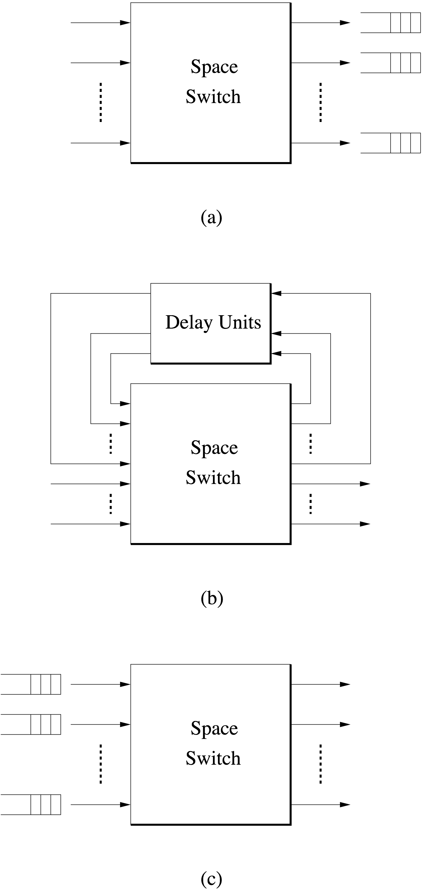
Optical packet switching
Buffering
  According to position of optical buffer,
  OPS nodes can be classified into
  following configurations
    (a) Output buffering
    (b) Recirculation buffering
    (c) Input buffering

Slide 17
Optical packet switching
Output buffering
  Output-buffered OPS node consists of a space switch with a buffer on each output port
  Contending packets arriving simultaneously at a particular output port are placed in corresponding output buffer
  Packets arriving at a full output buffer are discarded => packet loss
  Typically, acceptable probabilities for a packet being lost at single OPS node are in the range of 10⁻¹⁰ to 10⁻¹¹
  Many OPS node architectures are based on output buffering
  Usually, those OPS nodes emulate output-buffered space switch by means of virtual output queueing (VOQ)
  VOQ is usually deployed in input-buffered OPS nodes

Slide 18
Optical packet switching
Shared buffering
  May be viewed as a form of output buffering, where all output buffers share same memory space
  As a result, buffering capacity not restricted to number of packets in individual buffer but to total number of packets in all buffers together
  Commonly used in electronic switches using RAM
  In optical domain, shared buffering may be realized via FDLs that are shared among all output ports
  Shared-buffered OPS nodes able to achieve significantly reduced packet loss performance with much smaller switch sizes & fewer FDLs than output-buffered counterparts

Slide 19
Optical packet switching
Recirculation buffering
  Number of recirculating optical loops from some switch output ports are fed back into switch input ports
  Each optical loop has certain delay (e.g., one packet)
  Contention resolved by placing all but one packet into recirculating loops at expense of optical signal degradation
  Recirculating packets are forwarded onto intended output port as soon as contention clears

Slide 20
Optical packet switching
Input buffering
  Input-buffered OPS node consists of a space switch with a buffer attached to each input port
  Fundamental drawback is head-of-line (HOL) blocking
    Packet at head of input queue that cannot be forwarded to intended output port due to current contention blocks other packets within same input buffer whose intended output ports are free of contention
  As a consequence, input-buffered OPS nodes suffer from decreased throughput and increased delay & packet loss
  Input buffering can be enhanced with so-called look-ahead capability, which is too complex for optical networks
    Allows for selecting packets other than those at head of input buffer to be forwarded
  Alternatively, input buffer can be replaced with multiple VOQ buffers, one for each output port => no HOL blocking

Slide 21
Optical packet switching
Feed-forward vs. feedback configuration
  All aforementioned optical buffering schemes can be implemented in either single-stage or multiple-stage OPS nodes in the following two configurations
    Feed-forward configuration
      FDL feeds forward to next stage of OPS node
      Optical packets travel from one end of OPS node to the other, involving constant number of FDL traversals
    Feedback configuration
      FDL sends optical packets back to input of same stage
      Number of FDL traversals generally differs between optical packets

Slide 22
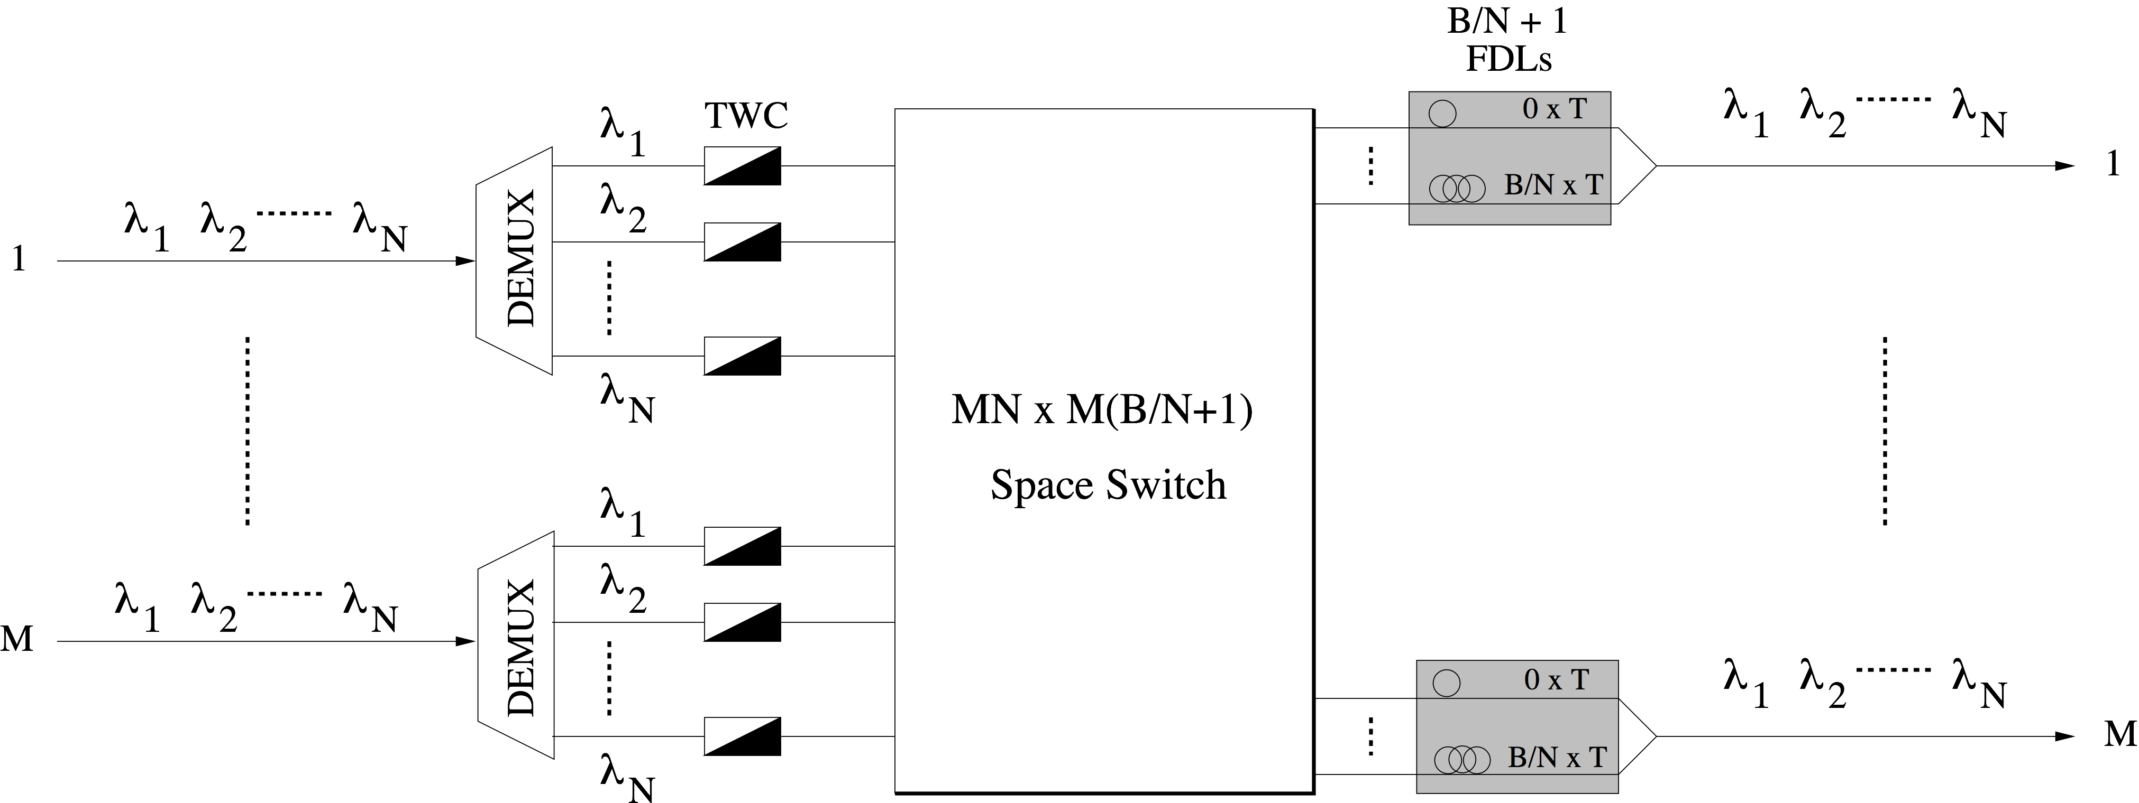
Optical packet switching
Wavelength conversion
  Another approach to resolve contention in OPS network nodes by converting optical packets destined for same output port to different wavelengths
  Can be applied in conjunction with buffering

Slide 23
Optical packet switching
Wavelength converters
  Tunable wavelength converters (TWCs)
    Improve packet loss performance of OPS nodes, especially for increasing number of wavelengths
    Reduce required number of FDLs in OPS nodes
  Limited-range wavelength converters (LRWCs)
    Allow for conversion of any input wavelength only to limited set of adjacent output wavelengths
    LRWC sharing schemes
      Shared-per-node OPS nodes
        All LRWCs placed in converter bank at switch output
      Shared-per-output-fiber OPS nodes
        Dedicated converter bank at each output fiber
        Smaller savings of LRWCs, but less complex control algorithms than shared-per-node approach

Slide 24
Optical packet switching
Contention resolution techniques: Limitations
  FDLs
    Offer only fixed & finite amounts of delay
    Increase delay
    Deteriorate optical signal quality
    May cause packet reordering
  Wavelength conversion
    Does not introduce significant delay increase
    Avoids packet reordering
  Deflection routing
    Does not require hardware upgrades at OPS nodes & can be easily done in software
    Packets may arrive out of order
    Less efficient than buffering & wavelength conversion
    Effectiveness strongly depends on network topology & traffic

Slide 25
Optical packet switching
Unified contention resolution
  Combines contention resolution techniques across time, wavelength, and space domains
  Obtained results
    Wavelength conversion is preferred technique, especially for increasing number of wavelengths & under heavy traffic loads
    Deflection routing can be good approach in OPS networks with high-connectivity topologies
    In general, however, deflection routing is least effective approach to resolve contention & should be used only in combination with other techniques
    Wavelength conversion combined with carefully designed buffering & deflection routing at selected OPS nodes achieves best results

Slide 26
Optical packet switching
Service differentiation
  Similar to contention resolution, service differentiation in OPS networks can be achieved by exploiting time, wavelength, and/or space dimensions
  QoS differentiation schemes utilizing only wavelength dimension for asynchronous OPS networks
    Access restriction
      Subset of resources (e.g., wavelengths, wavelength converters) reserved for high-priority traffic
    Preemption
      High-priority packet allowed to preempt resource currently occupied by low-priority packet
    Packet dropping
      Low-priority packets dropped with certain probability before attempting to utilize any resources

Slide 27
Optical packet switching
Service differentiation
  Preemption yields best performance in terms of loss probability, followed by access restriction & packet dropping, at expense of increased implementation complexity
  Aforementioned schemes can be deployed in combination with full-range wavelength converters (wavelength domain) & FDLs (time domain)
  Similar to contention resolution, wavelength domain is more effective than time domain to realize QoS differentiation in OPS networks

Slide 28
Optical packet switching
Self-routing
  Due to limited capability of current optical logic devices (AND, OR, and XOR) & their bulky nature, pure OPS networks may be built by deploying simple single-bit optical processing schemes => self-routing address scheme
    Each output port of all OPS nodes is associated with a bit in optical packet header
    Address contains 2K bits grouped into N address subfields, where K and N denote number of bidirectional links and number of OPS nodes, respectively
    Each address subfield corresponds to different OPS node
      For source & destination nodes, all bits are set to 0
      For intermediate node, only l-th bit set to 1 to indicate that optical packet exits output port l
    Each node optically processes its own address subfield
    Self-routing supports traffic engineering, but scales poorly

Slide 29
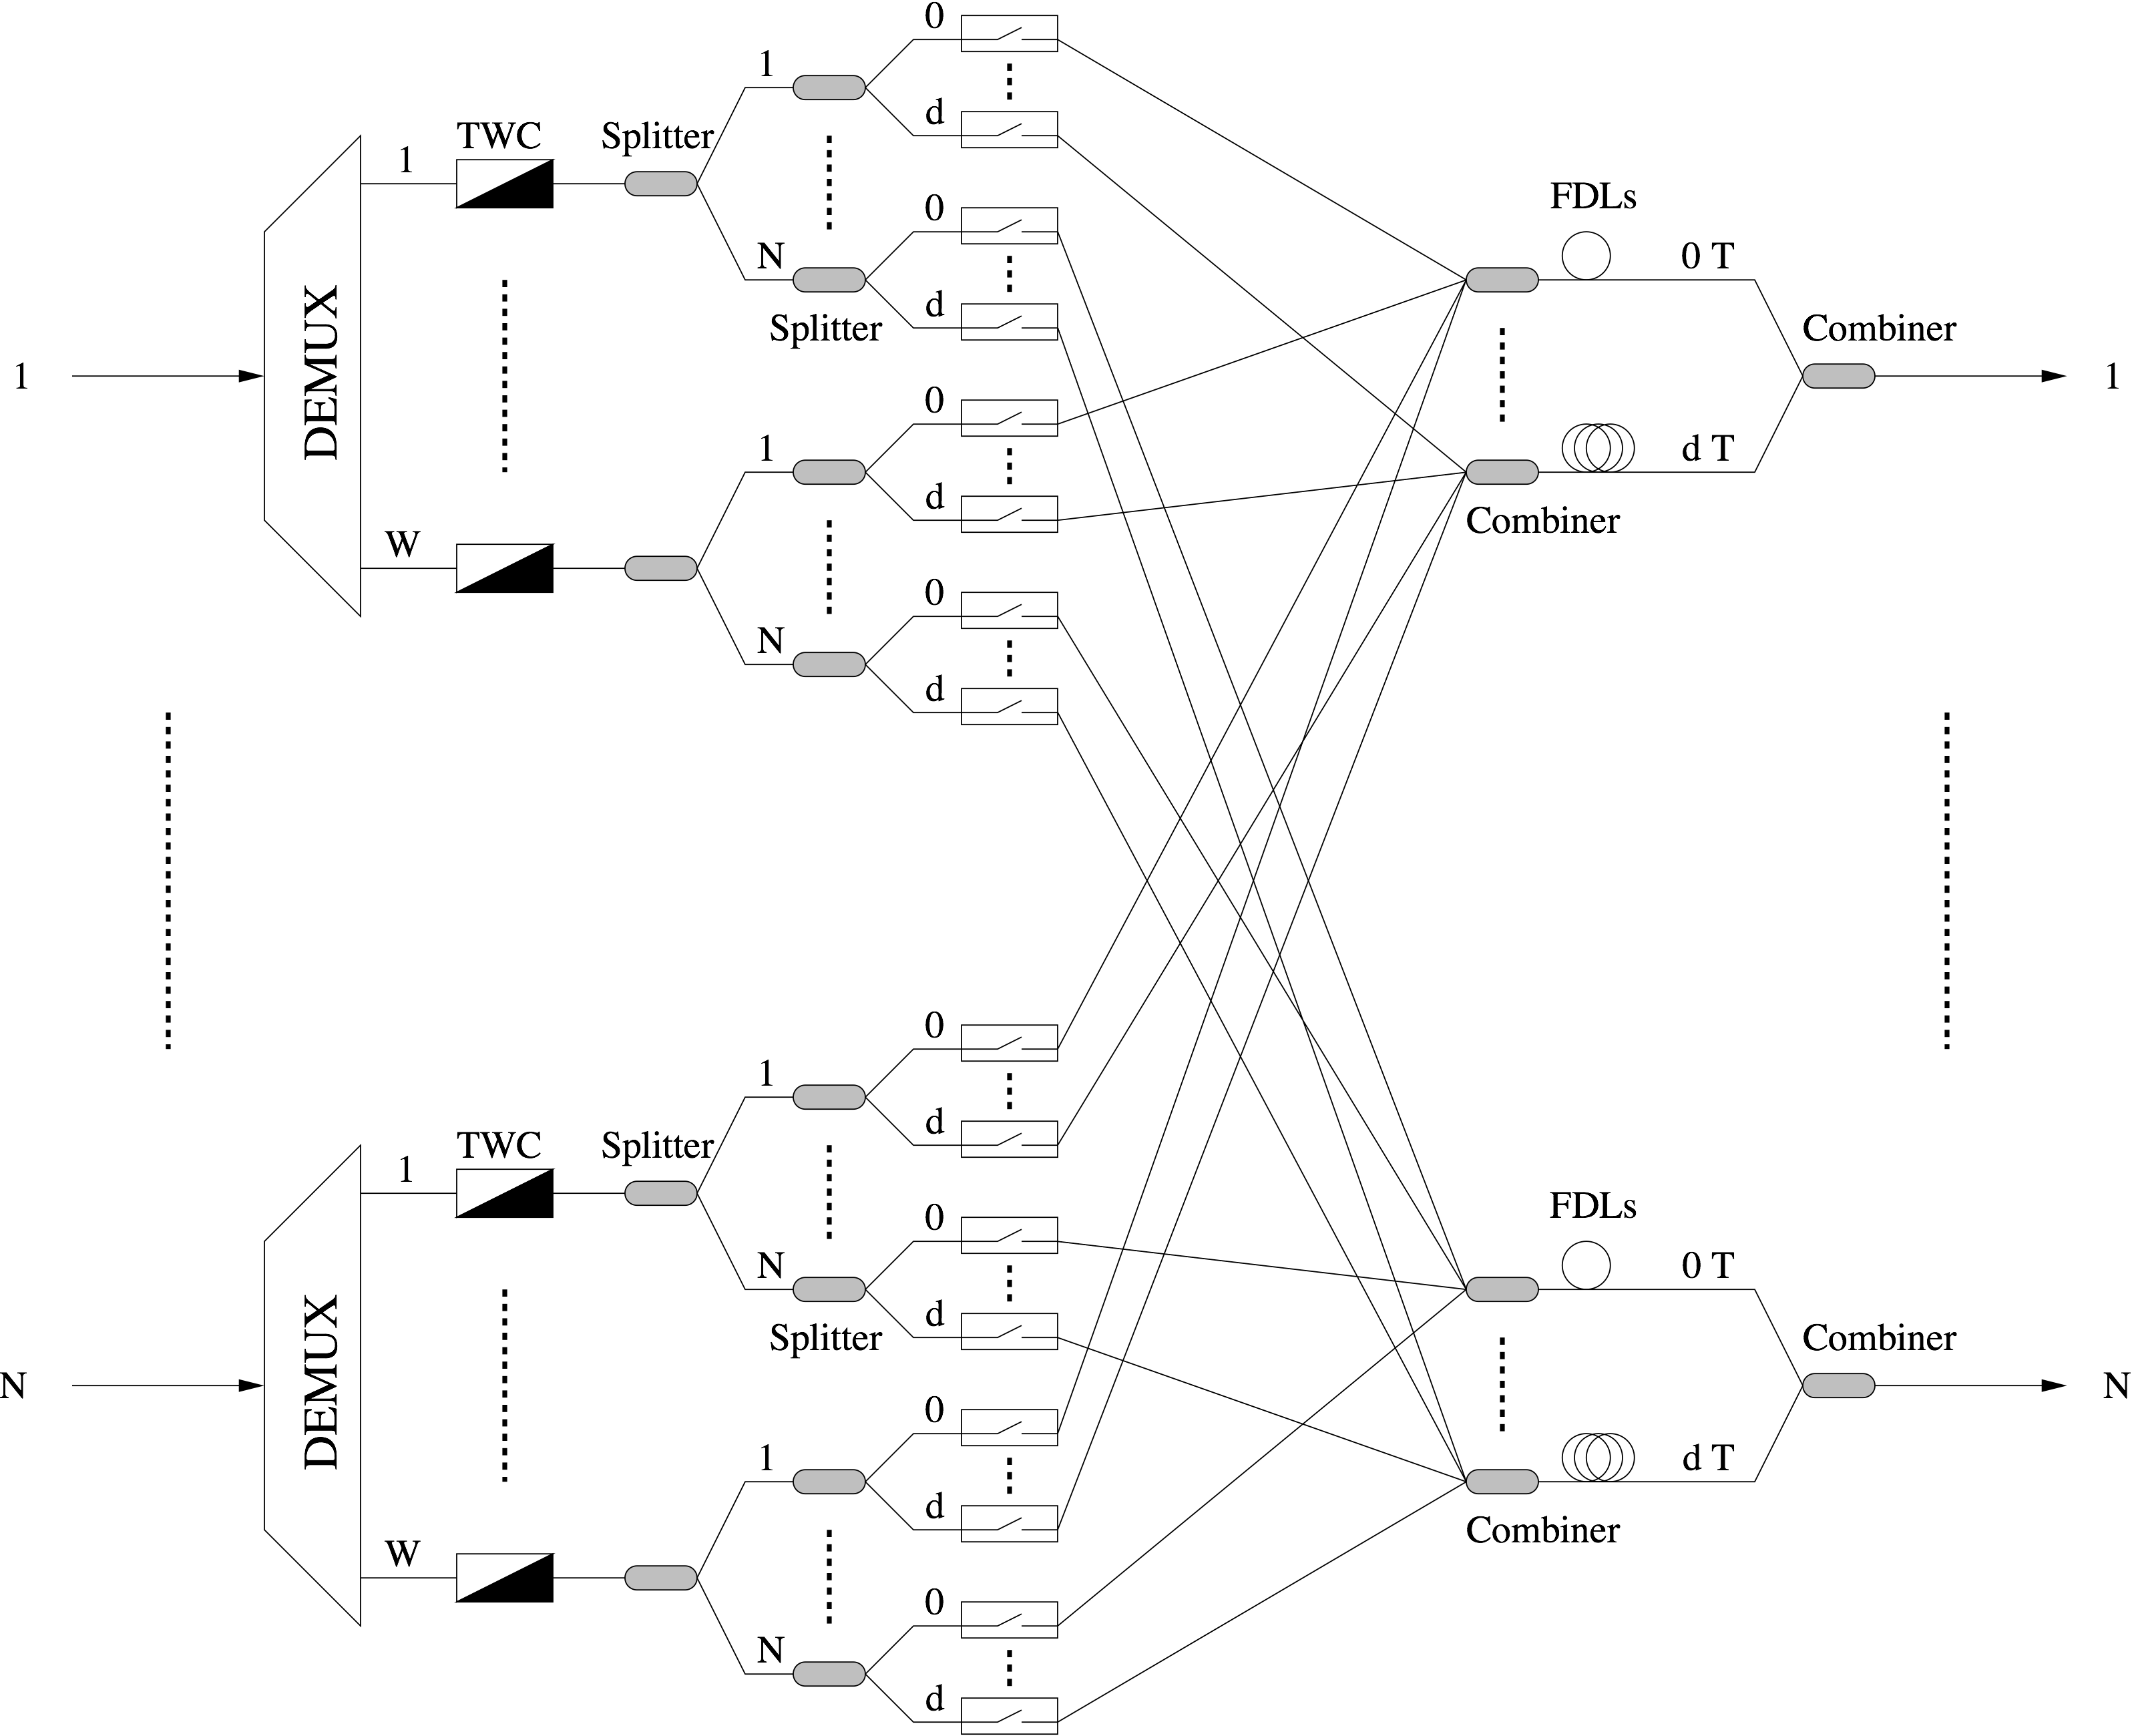
Optical packet switching
Space
switch
architecture

Slide 30
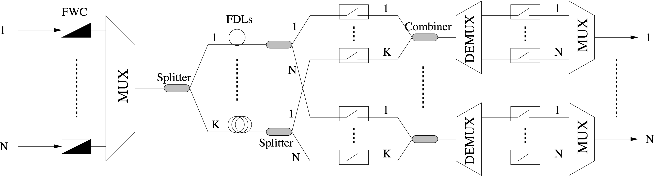
Optical packet switching
Broadcast-and-select architecture

Slide 31
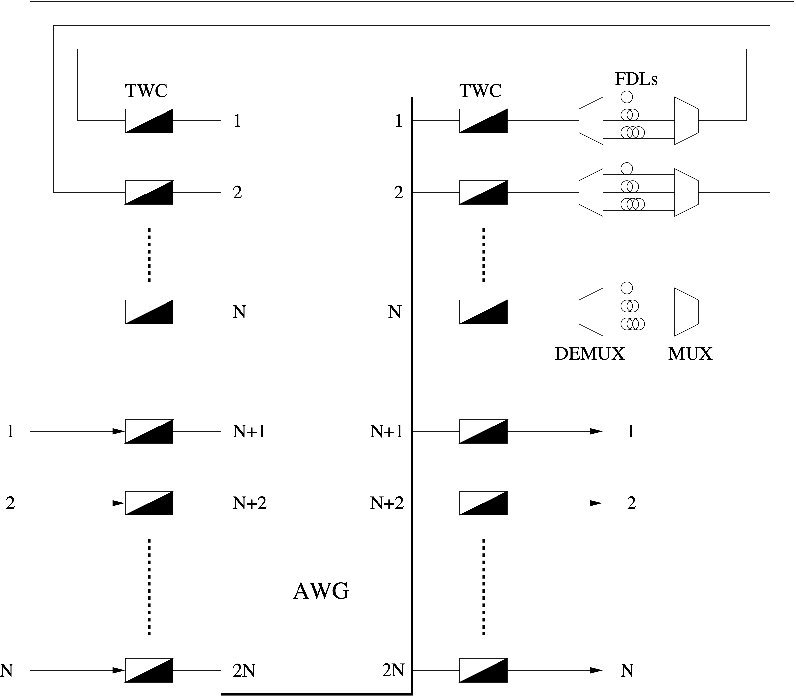
Optical packet switching
Wavelength-
routing
architecture

Slide 32
Optical packet switching
Implementation
  OPS ring
    Synchronous slotted unidirectional ring using single data wavelength channel & separate control wavelength
    Empty data slot used to send data packet, accompanied by control packet simultaneously sent on control wavelength
    Control packet contains destination address of data packet
    Control packet undergoes OEO conversion at each ring node, while data packet remains in optical domain
    Destination node drops data packet by setting 2x2 optical cross-bar switch to cross state
    Experimental demonstration of error-free operation at line rate of 40 Gb/s using readily available technologies
    Bandwidth guarantee & fairness can be achieved by letting master node create reserved slots that may be spatially reused

Slide 33
Optical packet switching
Implementation
  Interconnected WDM OPS rings
    IST project DAVID (data and voice integration over DWDM)
    Multiple synchronous slotted unidirectional WDM rings interconnected via nonblocking optical packet switching hub
    Hub comprises synchronization stages, space switch, and regeneration stages, if necessary
    Each WDM ring deploys separate control wavelength carrying status information of all data WDM channels in same slot
    Control information includes state (empty or occupied) of each wavelength & destination ring of entire WDM slot (PSR)
    Destination ring set by hub based on either explicit reservations or traffic measurements
    Unlike data wavelengths, control wavelength undergoes OEO conversion at all ring nodes
    Ring nodes can use empty slots for data packet transmission

Slide 34
Optical packet switching
Implementation
  WDM OPS rings
    Viability & cost-effectiveness comparison of WDM OPS rings using currently available electronic & optical technologies with alternative ring technologies (SONET/SDH, RPR) provided following findings
      WDM-enhanced RPR networks with OEO conversion of all wavelengths at each node appears most advantageous solution for current & near-term capacity requirements
      In medium to long term, WDM OPS rings expected to become competitive to meet ever-increasing capacity demands from tens to hundreds of Gb/s due to their optical transparency

